Slide 1
SHA and HMAC
By: Matthew Ng

Slide 2
What is SHA
SHA stands for Secure Hash Algorithm
It is based off the Merkle-Dangard hash function
There are 3 versions of it with one coming in 2012
SHA-0
SHA-1
SHA-2
SHA-3 (coming soon)
SHA-1 and SHA-2 were designed by the National Security Agency (NSA)

Slide 3
SHA-0
SHA-0 is a 160-bit hash function
It was briefly introduced in 1993 and quickly was revoked
It was revoked due to flaws in the system
Runs in 80 rounds

Slide 4
SHA-1
SHA-1 is a modification of SHA-0 to correct those flaws that it produced
Produces a 160-bit message digest (MD) that is on principle based on MD4.
The MD is then inputted into a Digital Signature Algorithm (DSA)
Which generates/verifies the signature for the message.
Runs in 80 rounds.

Slide 5
SHA-1 (continued)
Signing the MD makes the message more efficient since the MD is a smaller size then the message.
The same hash function is needed to verify the message.
SHA-1 was considered secure because it was computationally infeasible to find a message that corresponds to a given MD.
It was also hard to find two different messages that produce the same MD.
Any changes made to the messages will result in a different MD

Slide 6
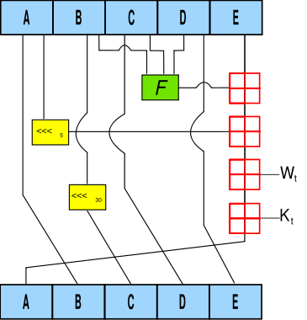
SHA-1 Algorithm (one round)
ABCDE are 32-bit words in the state
F is a non-linear function that varies
<<<_{n} is a left bit rotation by n places (n varies for each operation)
W_{t} is the expanded message word of round t
K_{t} is the round constant of round t
Boxes addition modulo 2³²

Slide 7
Attacks on SHA-1
Since SHA-1 is 160-bits
Birthday attack can find a collision in 2⁸⁰ trials
February 15, 2005 Wang, Yin, and Yu have found collisions in 2⁶⁹ trials
Is SHA-1 broken?
Not quite – The resources needed to break it is enormous
Considered the same amount of time to factor 760-bit RSA modulus
Only well-funded intelligence agencies can do it within a reasonable amount of time

Slide 8
SHA-2
SHA-2 consists of a set of 4 hash functions with the digests of (224, 256, 384, and 512-bits)
In 2005 security flaws were identified – math weakness may exist
SHA-1 attacks have not worked on SHA-2
SHA-224 and SHA-224 produces 32-bit words
SHA-384 and SHA-512 produces 64-bit words
They all use different shift amounts, constants, and number of rounds

Slide 9
SHA-2 (continued)
SHA-224 and SHA-384 are truncated versions of 256 and 512-bit.
But with different initial values
SHA-224 and SHA-256 runs in 64 rounds and SHA-384 and SHA-512 runs in 80 rounds
Although SHA-2 has better security it is not as widely used as SHA-1

Slide 10
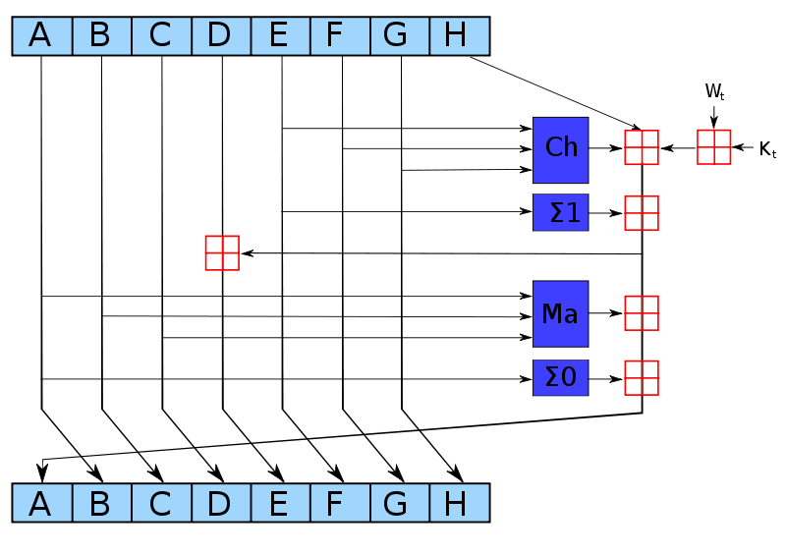
SHA-256 Algorithm (One iteration)

Slide 11
SHA-256 Algorithm (continued)
CH(E, F, G) = (E ∧ F) XOR (Ē ∧ G)
MA(A,B,C) = (A ∧ B) XOR (A ∧ C) XOR (B ∧ C)
Σ₀(A) = (A >>> 2) XOR (A >>> 13) XOR (A >>> 22)
Σ₁(E) = (E >>> 6) XOR (E >>> 11) XOR (E >>> 25)
The box is addition modulo

Slide 12
Attacks on SHA-2
There are two meet-in-the-middle preimage attacks
The first one attacks SHA-256 41/64 rounds in 2^{253.5} time with a space complexity of 2¹⁶ - SHA-512 46/80 rounds in 2^{511.5} time and space complexity of 2³
The second one attacks SHA-256 42/64 in 2^{251.7} time and 2¹² space complexity – SHA-512 42/80 in 2⁵⁰² time and space 2²²
Paper on 24-step - http://www.springerlink.com/content/g683083701265611/fulltext.pdf

Slide 13
Comparison of the SHA functions
Version | Output (bits) | Input (bits) | Block Size (bits) | Max Size/ Message | Word size | Rounds | Collisions?
SHA-0 | 160 | 160 | 512 | 2⁶⁴-1 | 32 | 80 | Yes
SHA-1 | 160 | 160 | 512 | 2⁶⁴-1 | 32 | 80 | Yes (2⁵¹⁾
SHA-256/224 | 256/224 | 256 | 512 | 2⁶⁴-1 | 32 | 64 | None
SHA-512/384 | 512/384 | 512 | 1024 | 2¹²⁸-1 | 64 | 80 | None

Slide 14
HMAC
HMAC stands for Hash-based Message Authentication Code
It used to verify data integrity and authenticity of a message
It uses current cryptographic hash functions with a secret key (SHA or MD5)
The name of the function changes depending on what hash function you use
MD5 would result to HMAC-MD5
SHA# would result to HMAC-SHA#

Slide 15
HMAC (continued)
The strength of HMAC relies on the strength of the HASH used and the Quality of the key
The outputted size is the same as the hash function
128-bit or 160-bit with SHA-1 or MD5

Slide 16
Terms
Some terms to help out with the next slide:
H = hash function
K = key
M = message
|| = concatenation
XOR = XOR
o_key_pad = outer padding (one block long 0x36)
i_key_pad = inner padding (one block long 0x5c)
In short:
HMAC(k,m) = H((k XOR o_key_pad) || H((k XOR i_key_pad) || m))

Slide 17
Pseudocode
Function hmac (k, m)
if(length(k) > blocksize) then
k = hash(k)
endif
if (length(k) < blocksize) then
k = k || (0x00 * (blocksize – length(k)))
endif
o_key_pad = (0x5c * blocksize) XOR k
i_key_pad = (0x36 * blocksize) XOR k
return hash(o_key_pad || hash(i_key_pad || m))
End Function

Slide 18
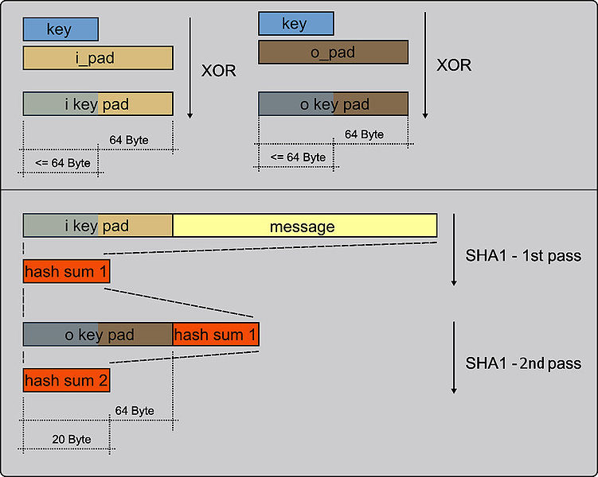
A visual look (using SHA-1)

Slide 19
Practical Reasons to use HMAC
E-Commerce sites use it
Used to help prevent fraudulent internet orders/transactions
For example – Carleton’s online payment system requires all the merchants to attach a HMAC with all the transactions sent to them.
The Virtual Ventures Registration System uses HMAC to verify merchant id and total amount to charge parents.
The payment system then rehashes the information and compares hashes to what has been sent over. If the information is the same then they can assume that the information is valid and sent by the merchant.
This will help in case attackers want to issue refunds to themselves.

Slide 20
HMAC – Fun facts
Using MD5 as the hashing function in HMAC does not seem to compromise the function in regards to the MD5 weaknesses.
Although SHA is much stronger, MD5 is best for performance if it is needed.
The most common attack against HMAC is brute force to get the secret key.
HMAC is substantially less affected by collisions than the hashing functions by itself.

Slide 21
Keys
A key can be of any length
However it is discouraged to be less than the length of the byte-length of the hash outputs
(16 for MD5, and 20 for SHA)
Keys need to be chosen at random
Long key length may be advisable if the randomness of the key is weak
Use a cryptographically strong pseudo-random generated with a random seed that is refreshed
This is generally a good security practice, and will limit the damage to keys and functions

Slide 22
References
HMAC - http://www.ietf.org/rfc/rfc2104.txt
Secure Hash Standard - http://www.itl.nist.gov/fipspubs/fip180-1.htm
FIPS PUB 198 - http://csrc.nist.gov/publications/fips/fips198/fips-198a.pdf
Crack in SHA-1 code ‘stuns’ security gurus - http://www.eetimes.com/electronics-news/4051783/Crack-in-SHA-1-code-stuns-security-gurus
Attacks on SHA-1 - http://www.openauthentication.org/pdfs/Attacks%20on%20SHA-1.pdf
http://eprint.iacr.org/2009/477.pdf

Slide 23
Quiz
What does HMAC and SHA stand for?
Who designed SHA-1 and SHA-2?
What is the formula for HMAC?
What are the 4 sets of hashes for SHA-2?
How many rounds does SHA-256 have?
How long does a key have to be for HMAC?

